Slide 1

Randomized dual coordinate ascent with arbitrary sampling
Optimization & Big Data Workshop
Edinburgh, 6th to 8th May, 2015
Zheng Qu
University of Edinburgh
Joint work with Peter Richtárik (Edinburgh) & Tong Zhang (Rutgers & Baidu)

Slide 2


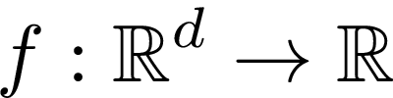
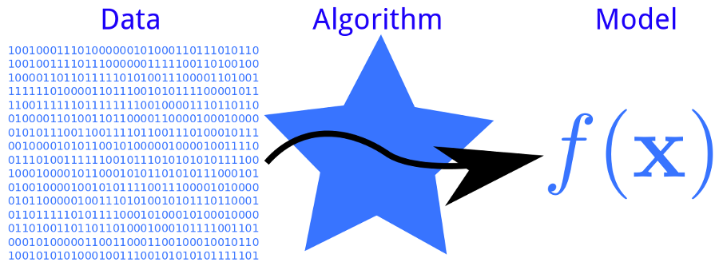




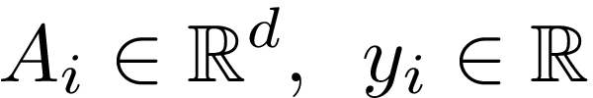

Supervised Statistical Learning
Training set of data
Predictor
Data Algorithm Predictor
GOAL
A_i \in \R^d, \enspace y_i \in \R
label (e.g. spam/no spam, stock price)
\mathrm{Find}\enspace w\in \R^d :
Predicted label
input (e.g., image, text, clinical measurements, …)
True label
Notes:
Statistical learning deals with the task of learning from data.
In the scenario of supervised statistical learning, we have an input, such as an image, a piece of text, a patient’s blood pressure, etc. and an output which we call label such as spam or non spam, heart attack or no heart attack. Both input and label can be represented through multidimensional vectors and for simplicity I am going to assume that each of my input is a d dimensional vector and each of my label is just a real number.
The pair of input and label follows some unknown distribution and our goal is to find out a linear predictor, represented through a vector w, such that given an input measurement A_i, A_i transpose w is a prediction of the associated true label y_i.

Slide 3




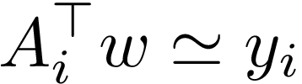
Supervised Statistical Learning
Training set of data
Predictor
Data Algorithm Predictor
GOAL
A_i \in \R^d, \enspace y_i \in \R
Input
Label
label
\mathrm{Find}\enspace w\in \R^d :
Predicted label
Label
True label
Predicted label
input
True label
Notes:
Statistical learning deals with the task of learning from data.
In the scenario of supervised statistical learning, we have an input, such as an image, a piece of text, a patient’s blood pressure, etc. and an output which we call label such as spam or non spam, heart attack or no heart attack. Both input and label can be represented through multidimensional vectors and for simplicity I am going to assume that each of my input is a d dimensional vector and each of my label is just a real number.
The pair of input and label follows some unknown distribution and our goal is to find out a linear predictor, represented through a vector w, such that given an input measurement A_i, A_i transpose w is a prediction of the associated true label y_i.

Slide 4
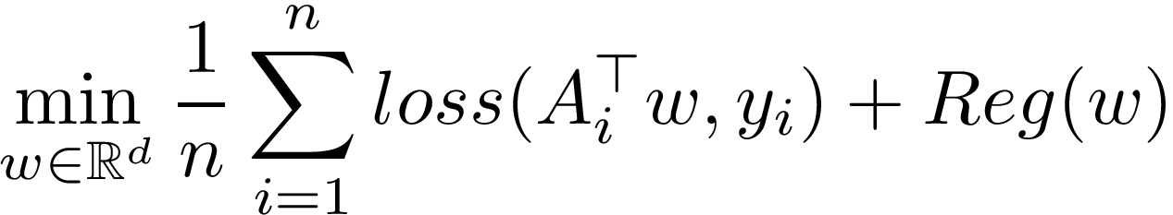
Empirical Risk Minimization
Training set of data
Predictor
Data Algorithm Predictor
GOAL
A_i \in \R^d, \enspace y_i \in \R
Input
Label
label
\mathrm{Find}\enspace w\in \R^d :
n = # samples (big!)
Predicted label
Label
input
True label
empirical risk
regularization
Notes:
Statistical learning deals with the task of learning from data.
In the scenario of supervised statistical learning, we have an input, such as an image, a piece of text, a patient’s blood pressure, etc. and an output which we call label such as spam or non spam, heart attack or no heart attack. Both input and label can be represented through multidimensional vectors and for simplicity I am going to assume that each of my input is a d dimensional vector and each of my label is just a real number.
The pair of input and label follows some unknown distribution and our goal is to find out a linear predictor, represented through a vector w, such that given an input measurement A_i, A_i transpose w is a prediction of the associated true label y_i.

Slide 5
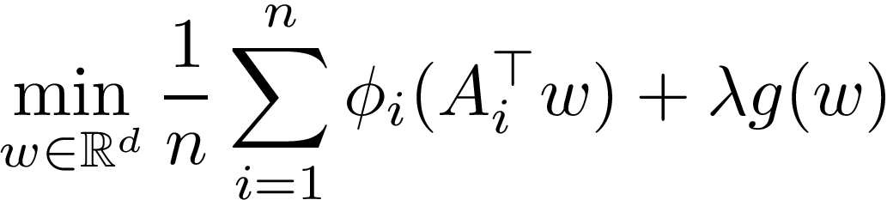
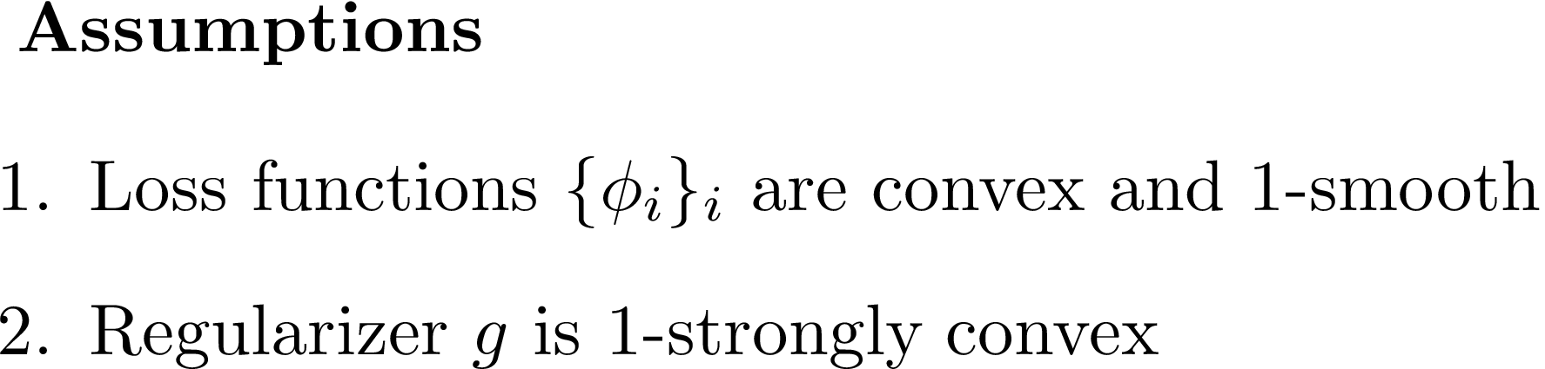
Empirical Risk Minimization
ERM problem:
n = # samples (big!)
\[(A_1,y_1), (A_2,y_2), \dots, (A_n,y_n)\sim \emph{Distribution}\]
empirical loss
regularization
\[\min_{w\in \mathbb{R}^d} \frac{1}{n}\sum_{i=1}^n loss(A_i^\top w, y_i)\]

Slide 6



Algorithm:
QUARTZ
Z. Q., P. Richtárik (UoE) and T. Zhang (Rutgers & Baidu Big Data Lab, Beijing)
Randomized dual coordinate ascent with arbitrary sampling
arXiv:1411.5873, 2014

Slide 7
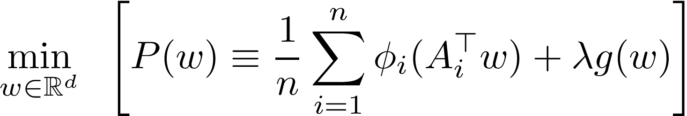
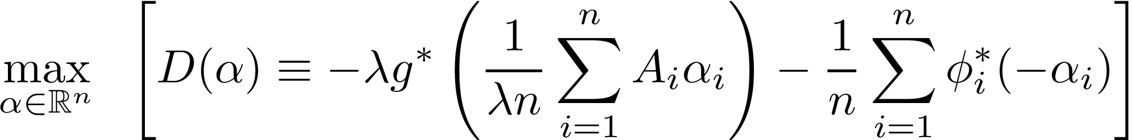

Primal-Dual Formulation
\[\min_{w\in \mathbb{R}^d}\;\; \left[ P(w) \equiv \frac{1}{n}\sum_{i=1}^n \phi_i(A_i^\top w) + \lambda g(w)\right]\]
ERM problem
Fenchel conjugates:
Dual problem

Slide 8




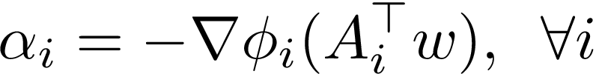
Intuition behind QUARTZ
Fenchel’s inequality
weak duality
Optimality conditions

Slide 9

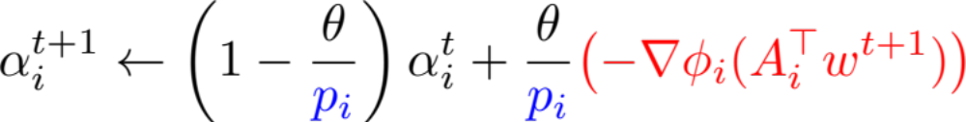

The Primal-Dual Update
Optimality conditions
STEP 1: PRIMAL UPDATE
STEP 2: DUAL UPDATE

Slide 10
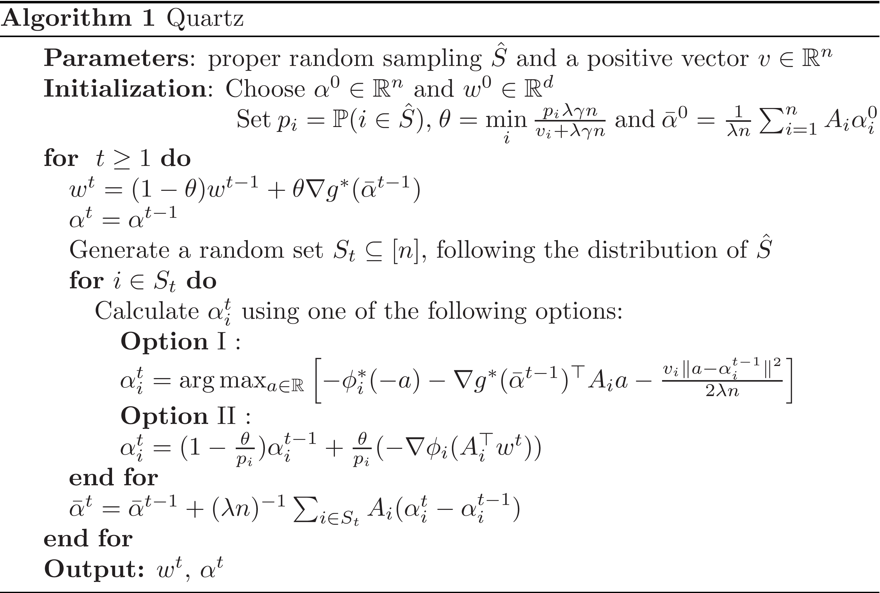

STEP 1: Primal update
STEP 2: Dual update
Just maintaining

Slide 11
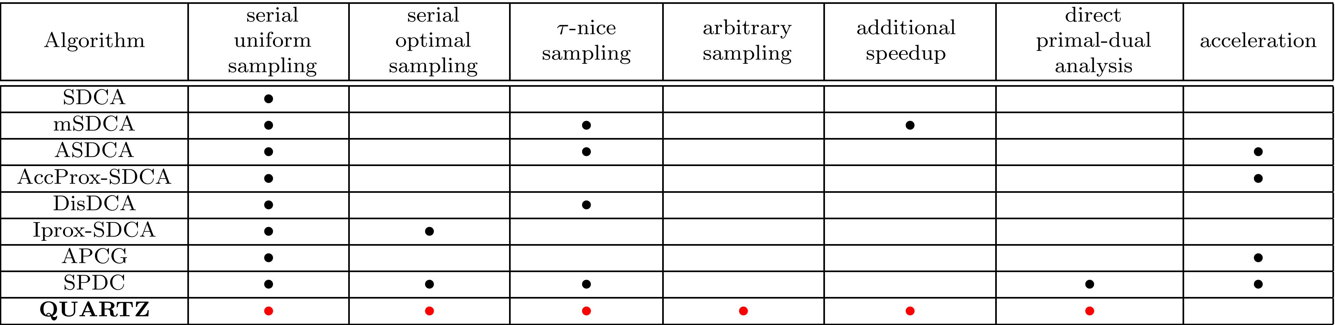
Randomized Primal-Dual Methods
SDCA: SS. Shwartz & T. Zhang, 09/2012
mSDCA M. Takáč, A. Bijral, P. Richtárik & N. Srebro, 03/2013
ASDCA: SS. Shwartz & T. Zhang, 05/2013
AccProx-SDCA: SS. Shwartz & T. Zhang, 10/2013
DisDCA: TB. Yang, 2013
Iprox-SDCA: PL. Zhao & T. Zhang, 01/2014
APCG: QH. Lin, Z. Lu & L. Xiao, 07/2014
SPDC: Y. Zhang & L. Xiao, 09/2014
QUARTZ: Z. Q., P. Richtárik & T. Zhang, 11/2014
Notes:
notes

Slide 12
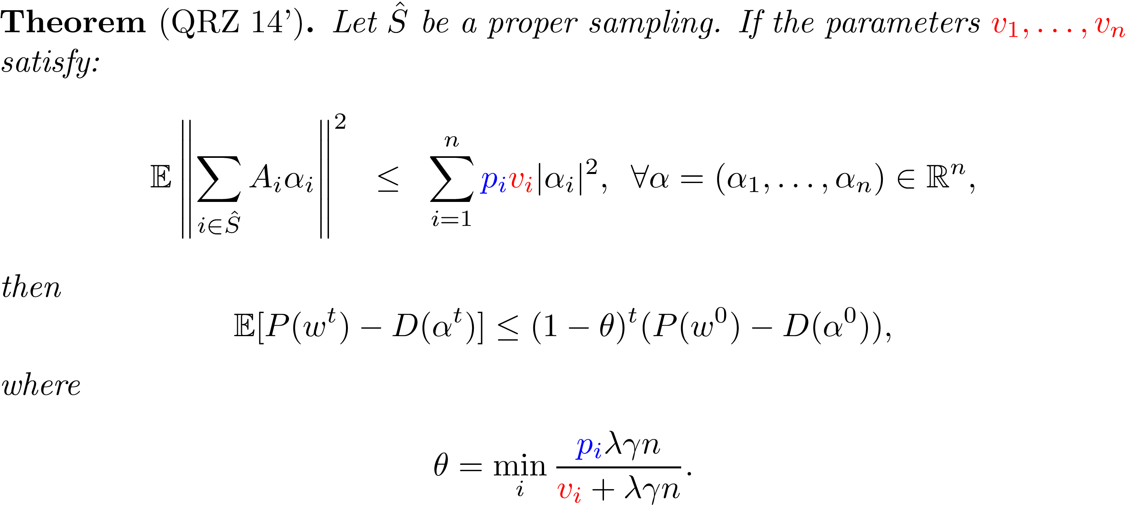
Convergence Theorem
Separable
ESO Assumption
Expected
Overapproximation
Convex combination constant
Notes:
notes

Slide 13
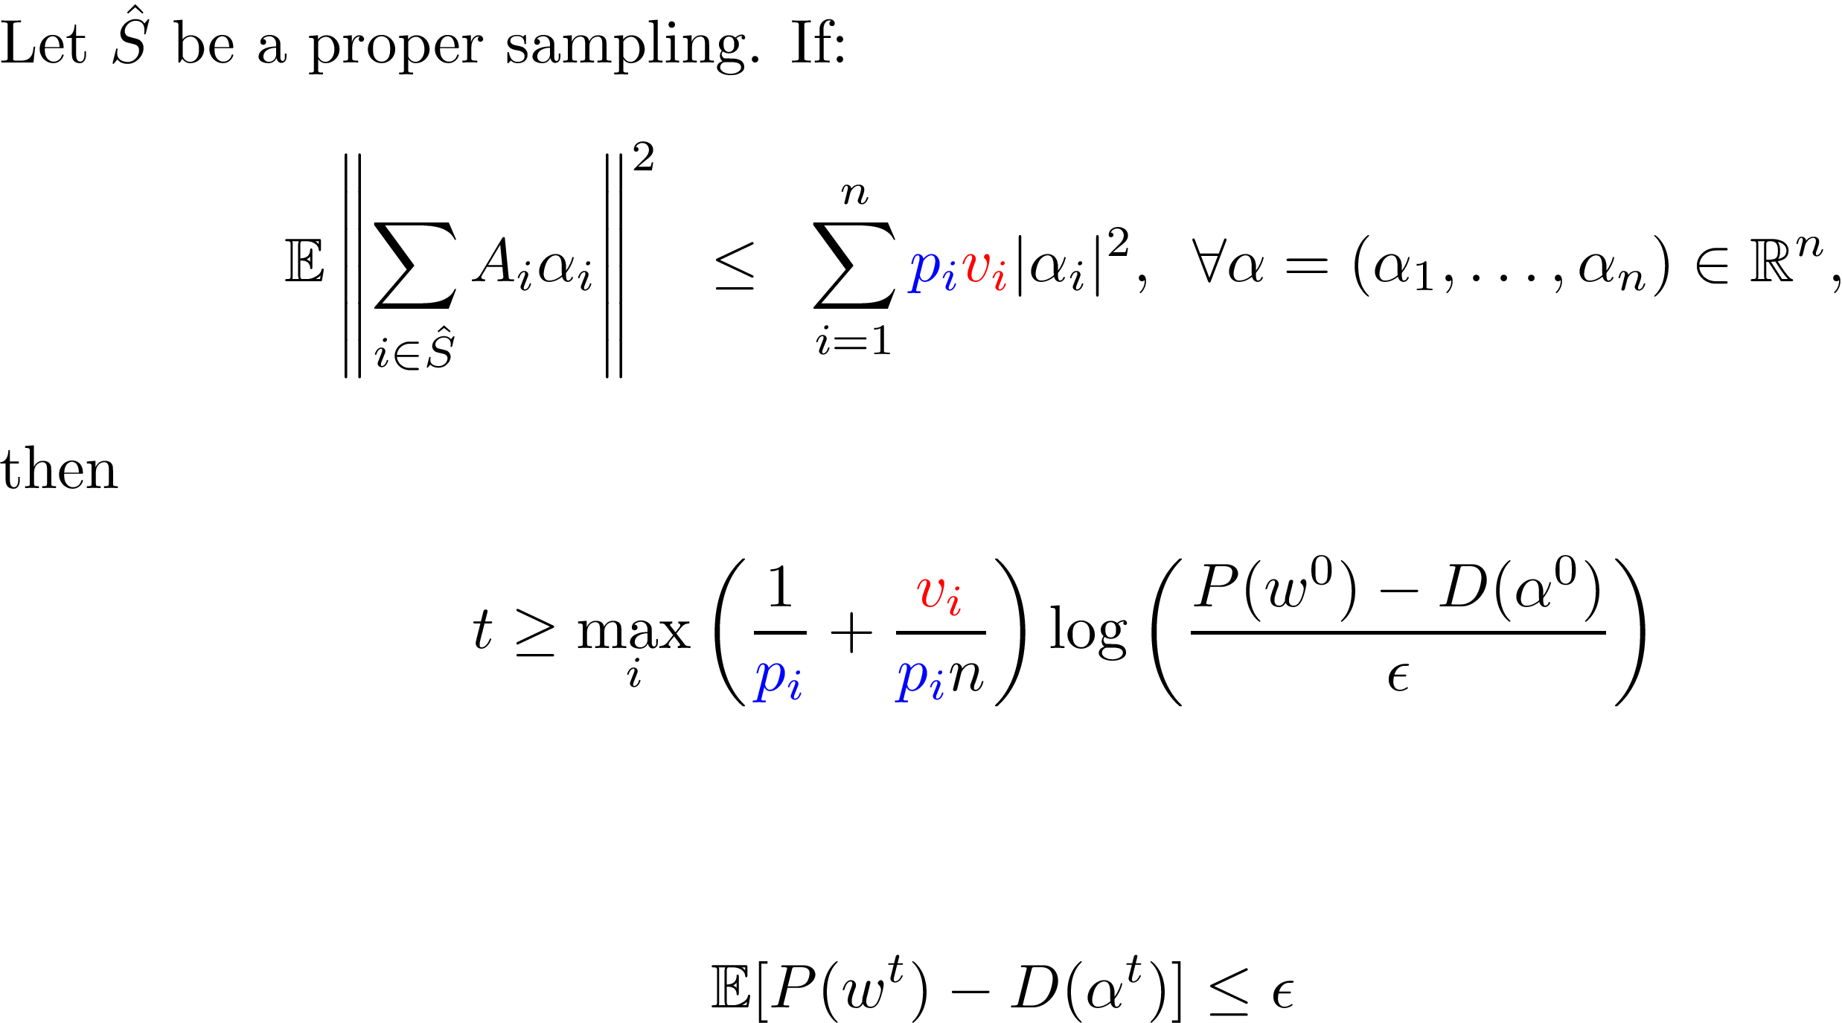
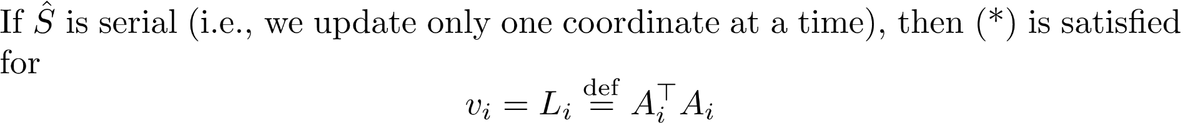
Iteration Complexity Result
(*)
Notes:
notes

Slide 14
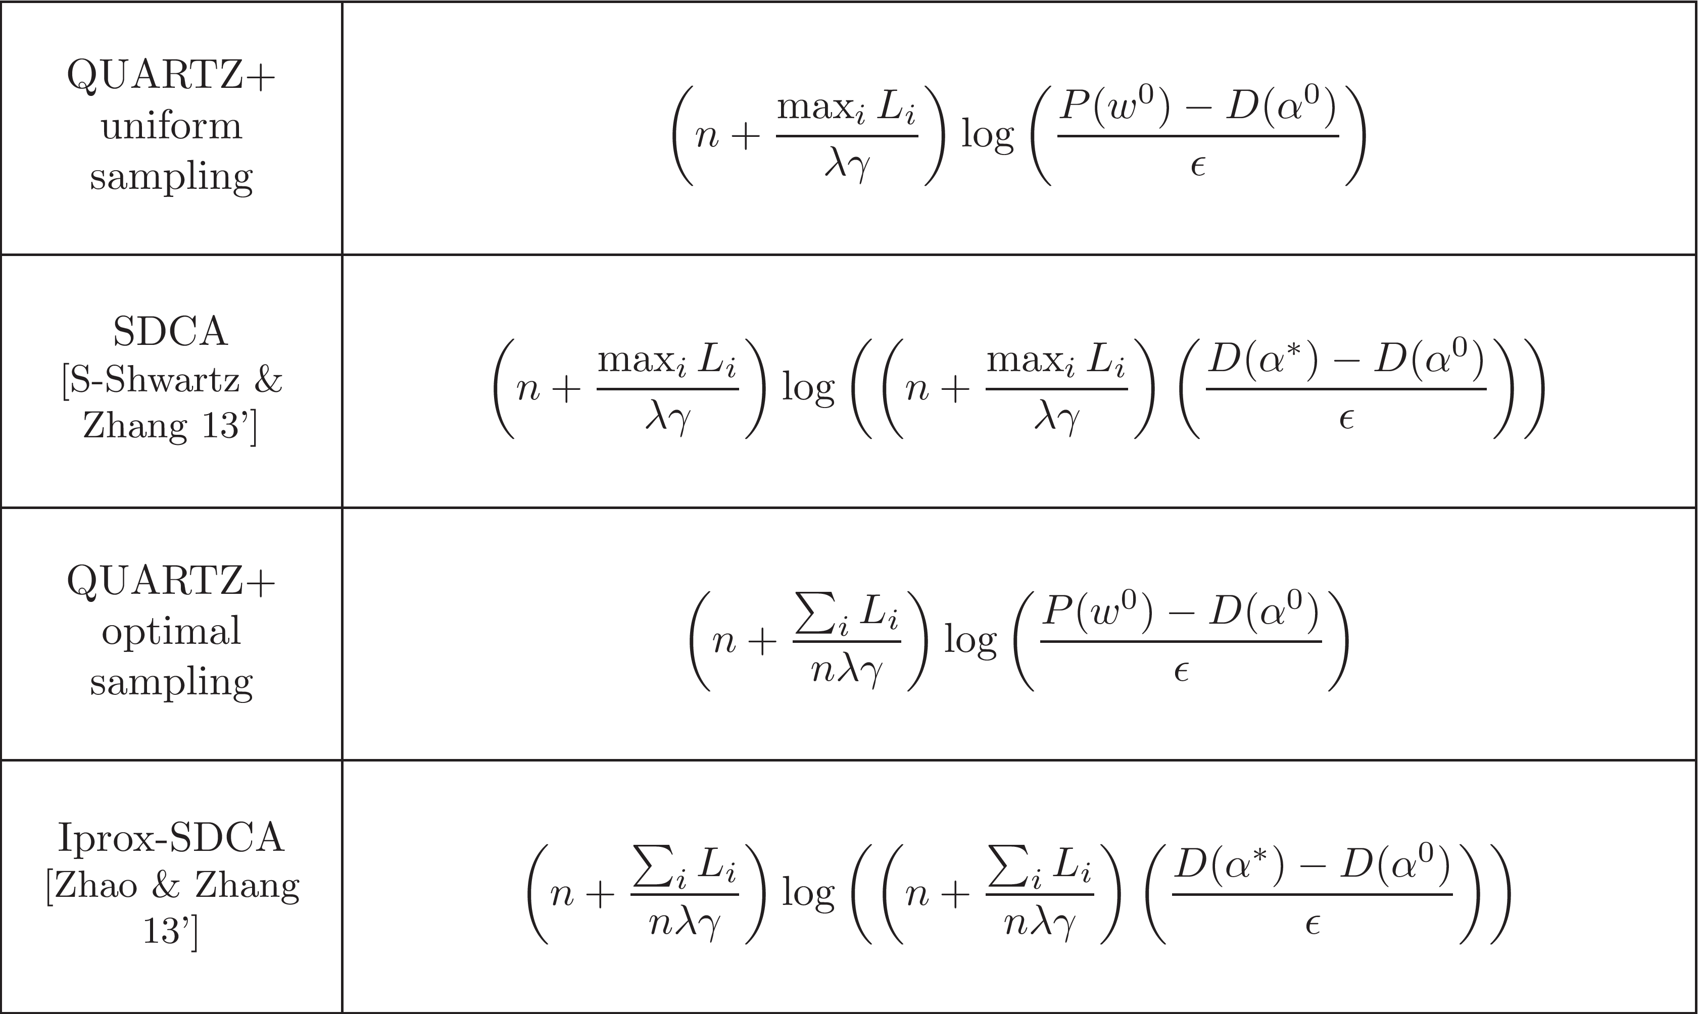
Complexity Results for Serial Sampling
Notes:
notes

Slide 15
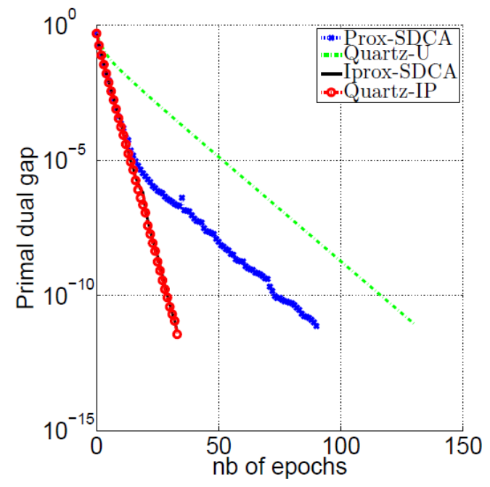
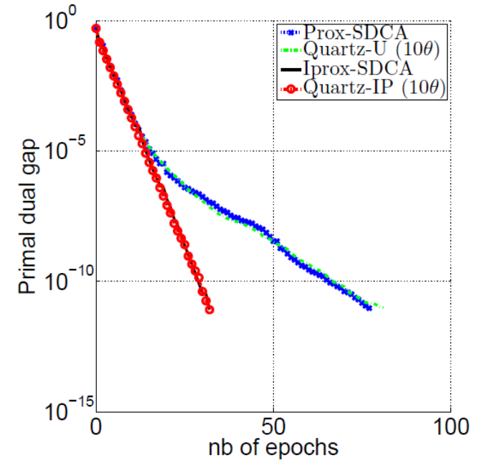
Experiment: Quartz vs SDCA, uniform vs optimal sampling
Notes:
notes

Slide 16
QUARTZ with Standard Mini-Batching
Notes:
notes

Slide 17
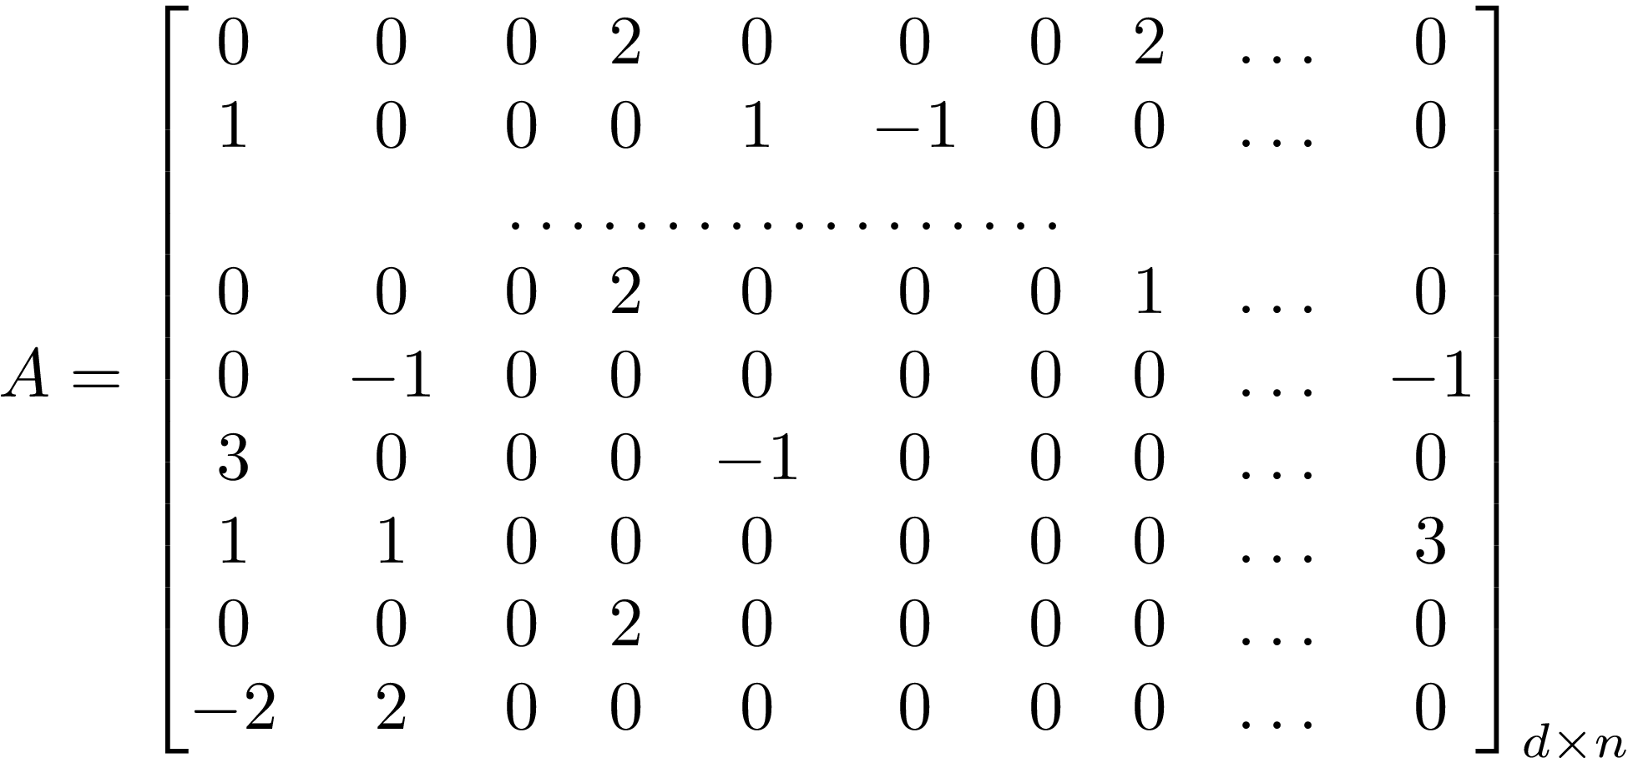

Data Sparsity
“Fully sparse data”
A normalized measure of average sparsity of the data
“Fully dense data”
Notes:
notes

Slide 18

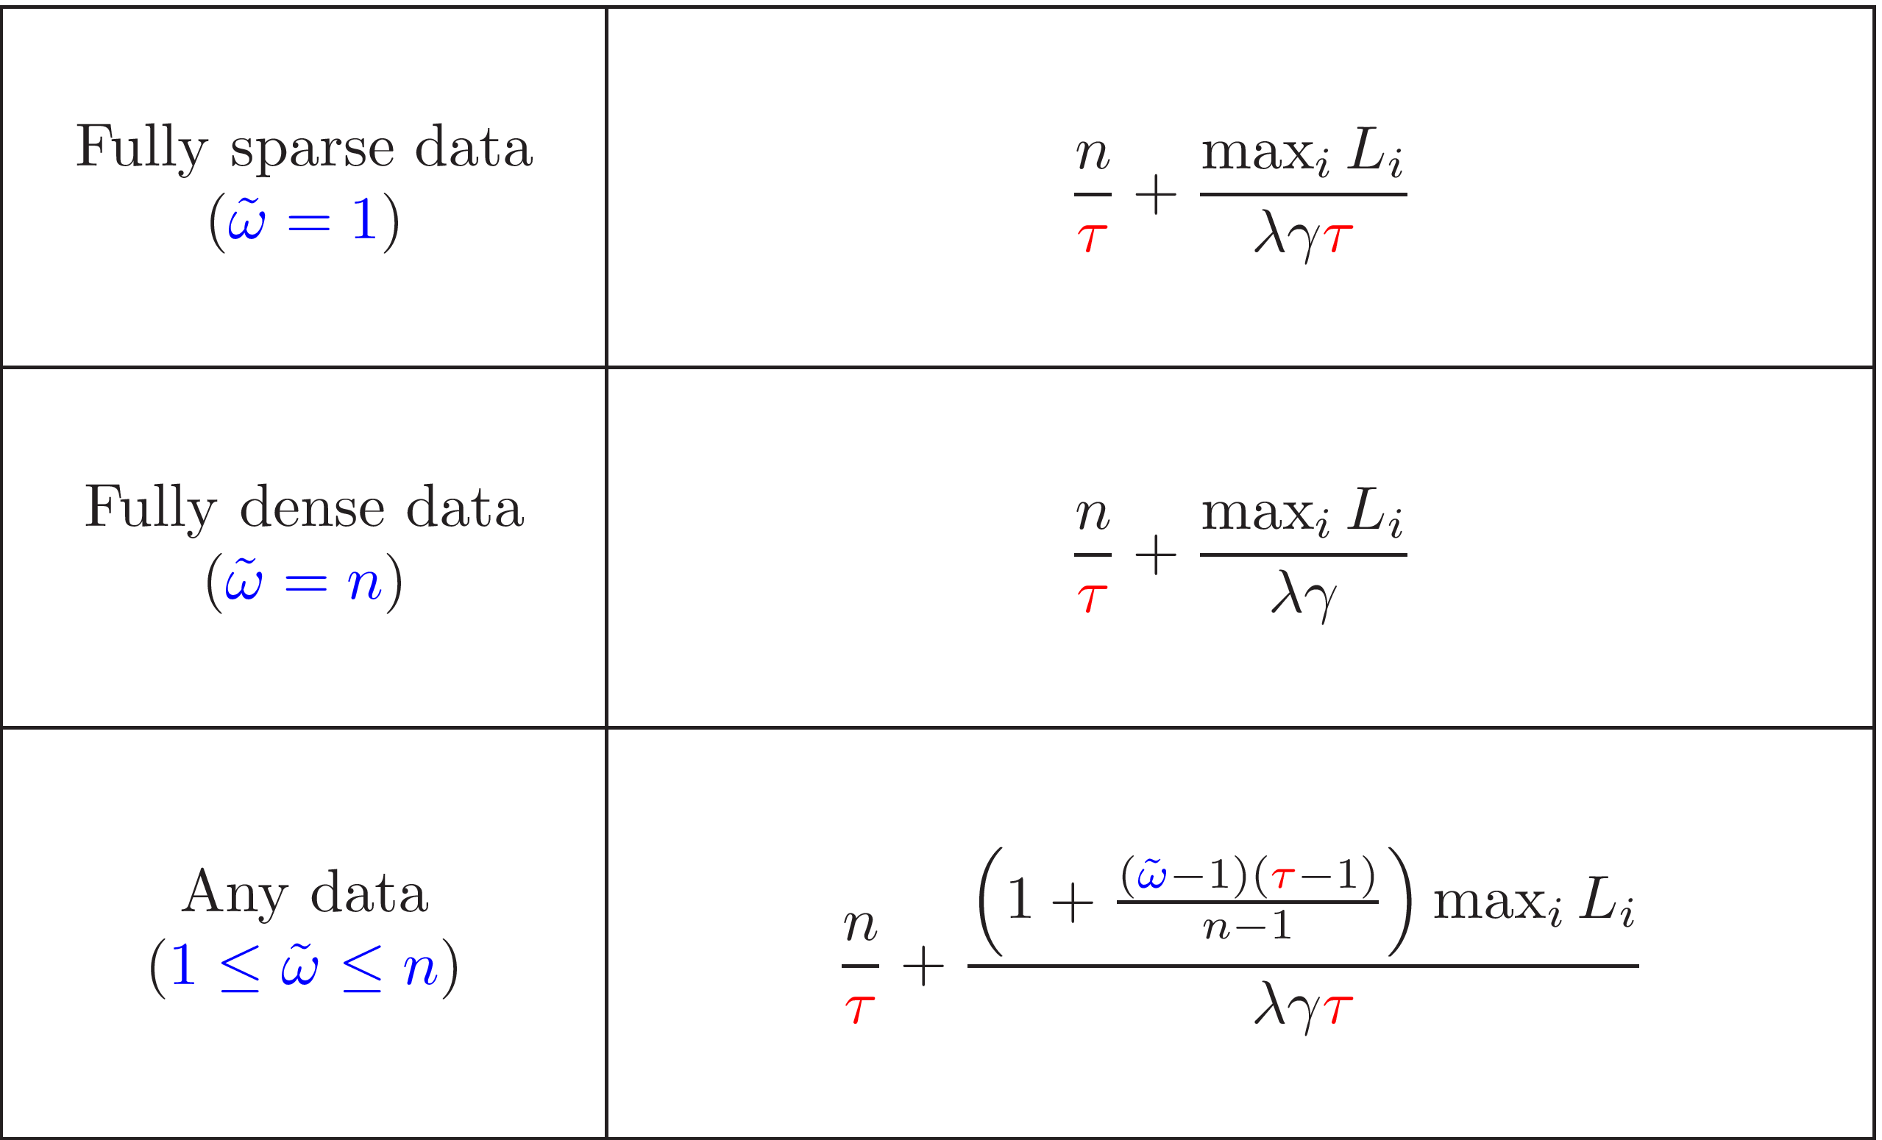
Iteration Complexity Results
Notes:
notes

Slide 19
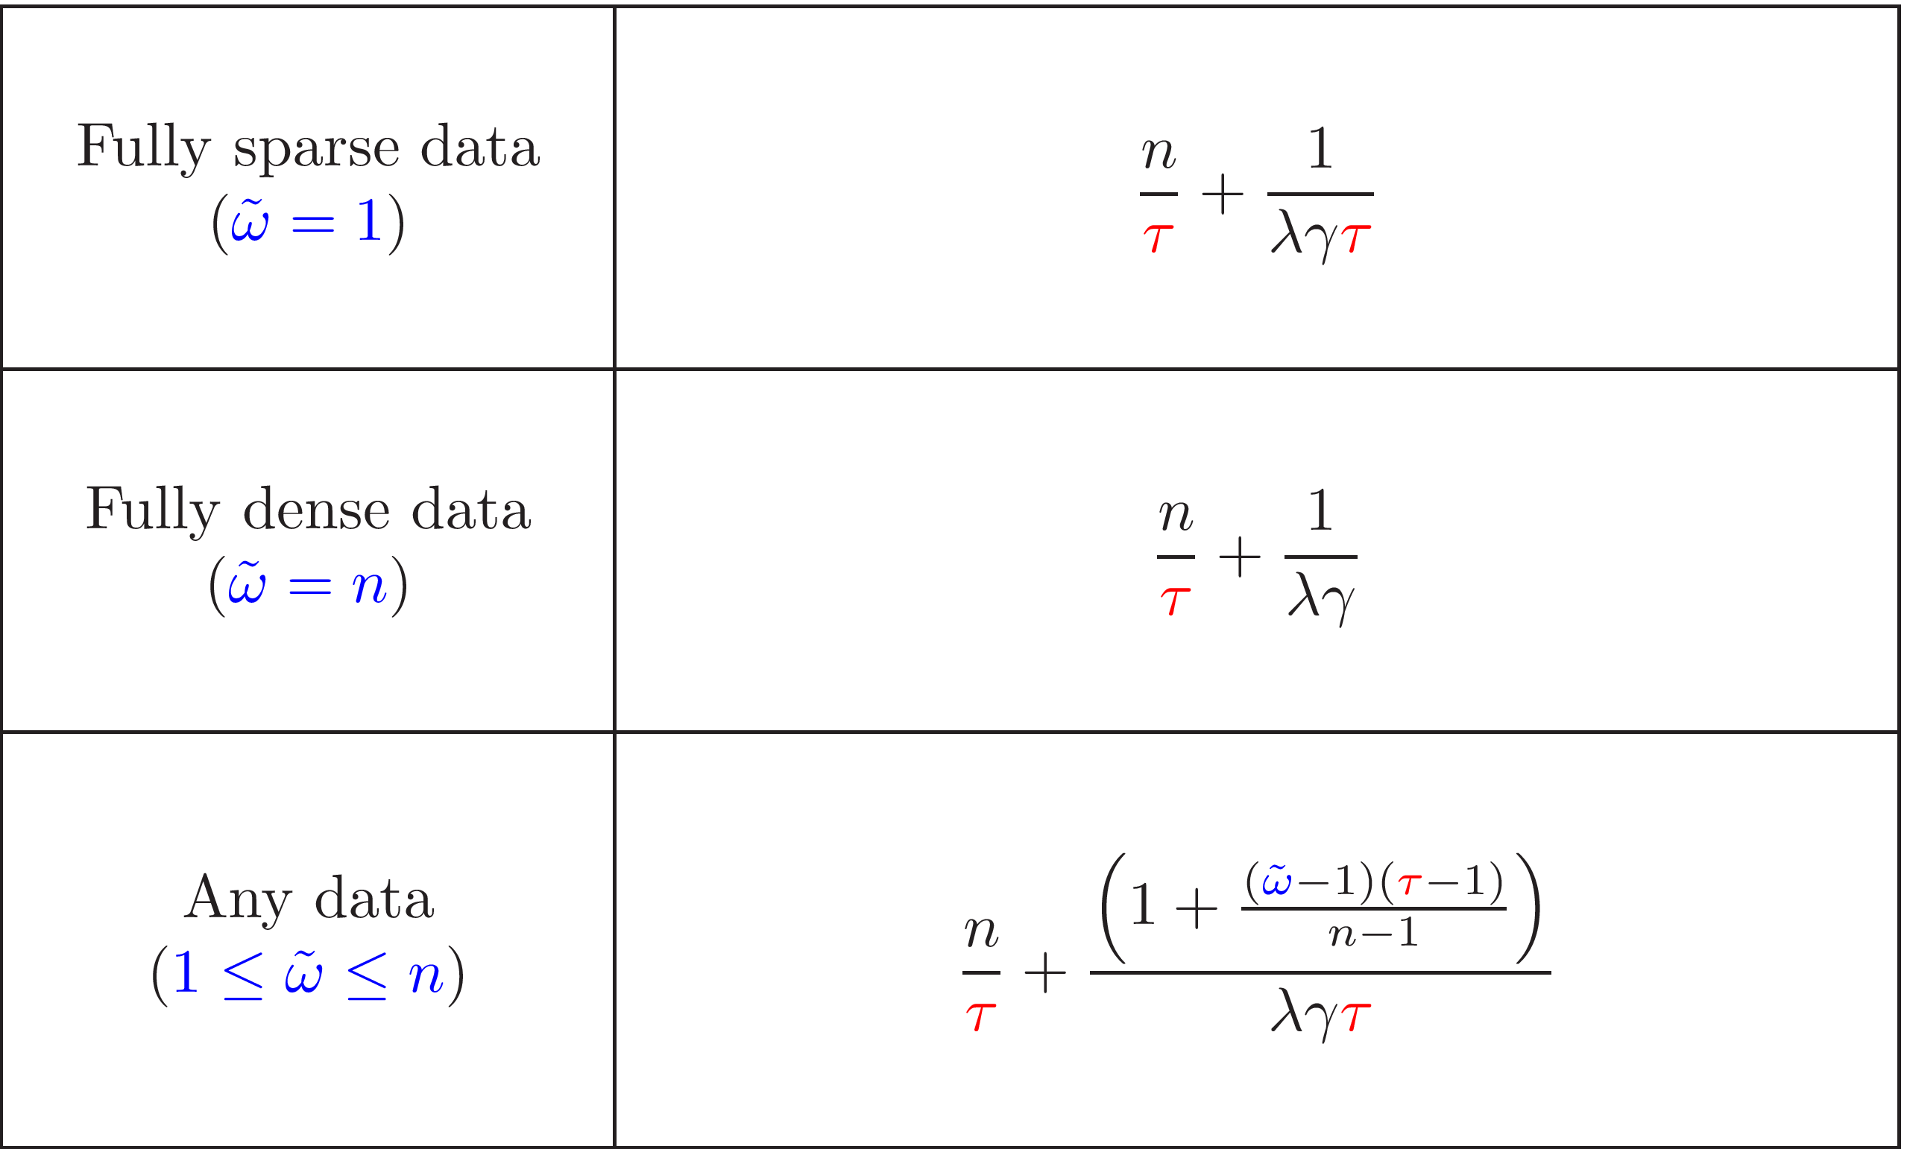

Iteration Complexity Results
Notes:
notes

Slide 20
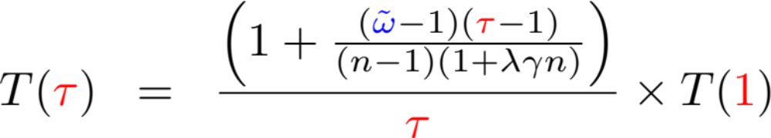
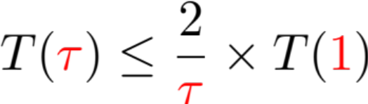

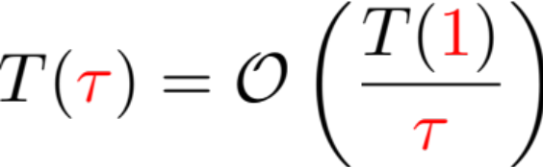

Theoretical Speedup Factor
Linear speedup up to a certain data-independent mini-batch size:
Further data-dependent speedup:
Notes:
notes

Slide 21
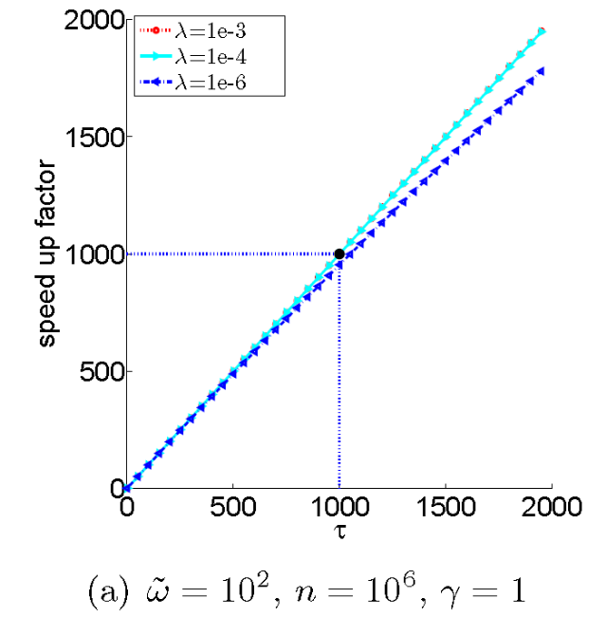
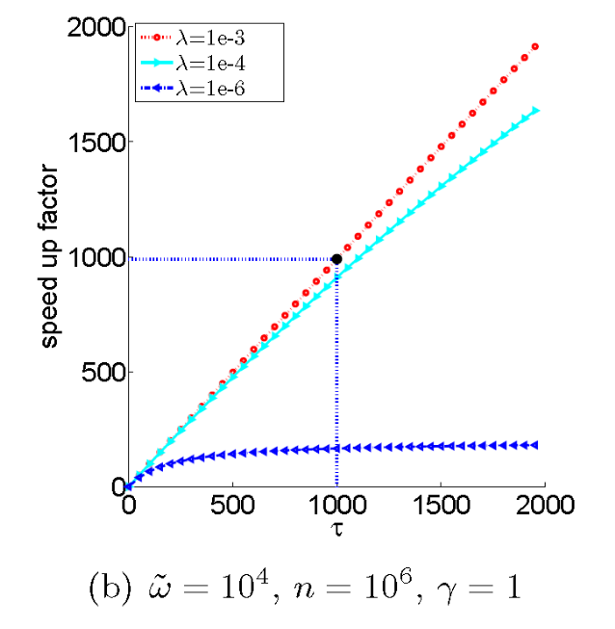
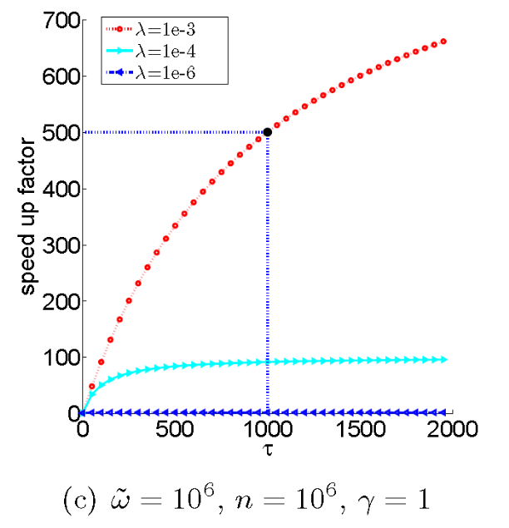
Plots of Theoretical Speedup Factor
Linear speedup up to a certain data-independent mini-batch size:
Further data-dependent speedup:
Notes:
notes

Slide 22
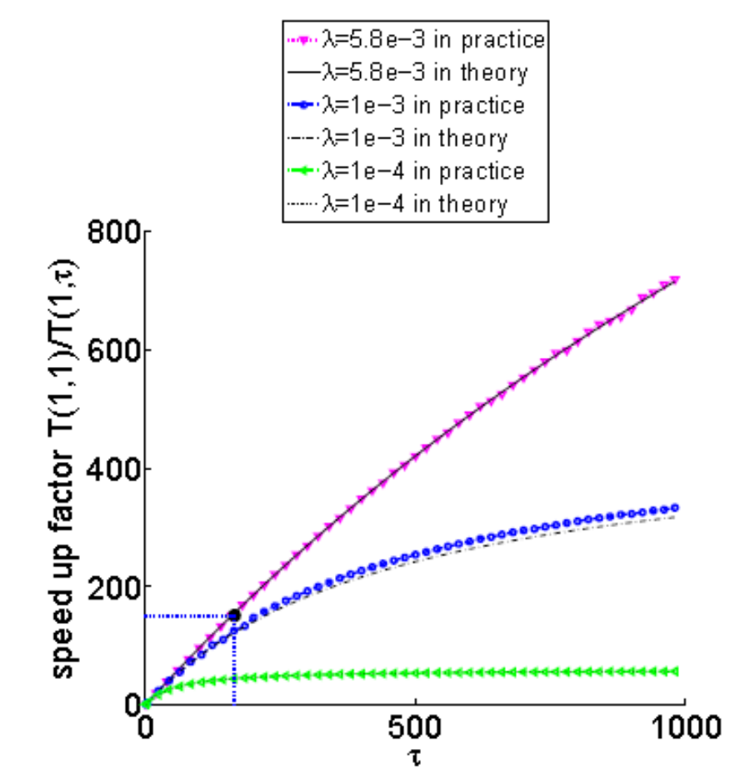
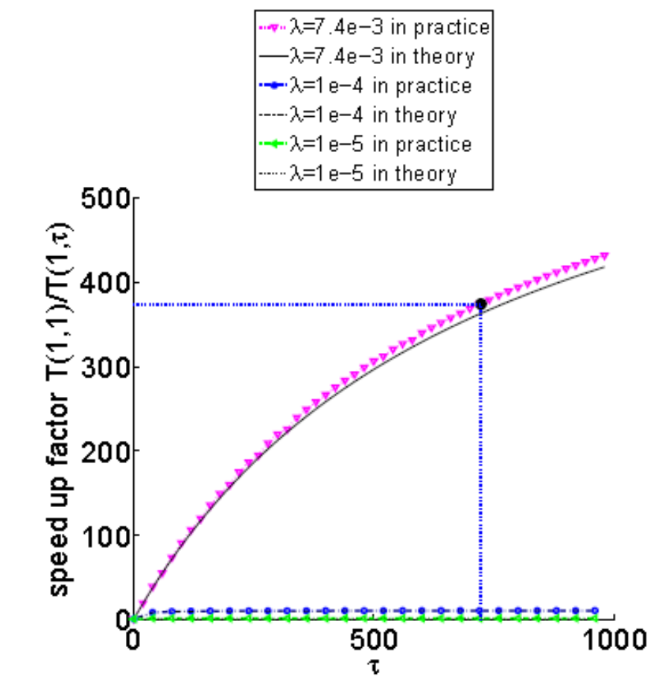
Theoretical vs Pratical Speedup
astro_ph; sparsity: 0.08%; n=29,882;
cov1; sparsity: 22.22%; n=522,911;
Notes:
notes

Slide 23
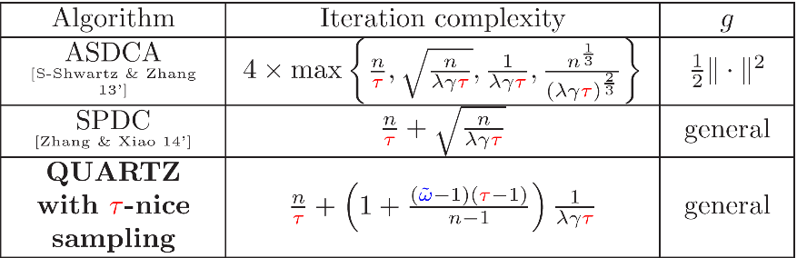
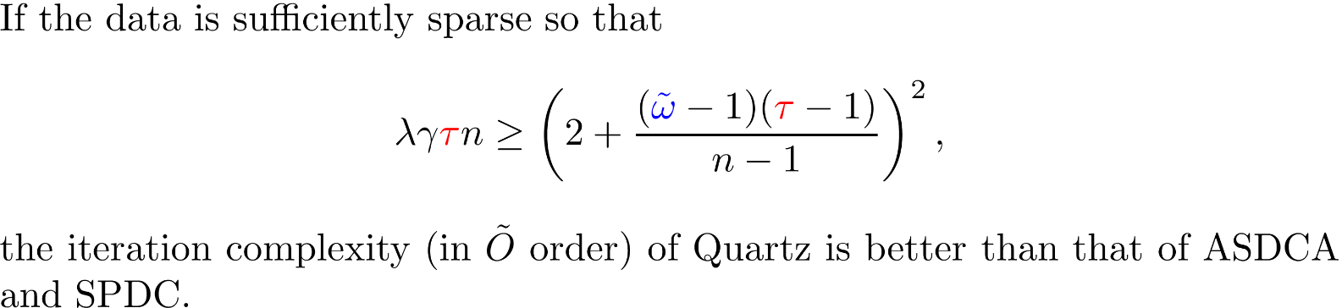
Comparison with Accelerated Mini-Batch P-D Methods
Notes:
notes

Slide 24








Distribution of Data
n = # dual variables
Data matrix

Slide 25
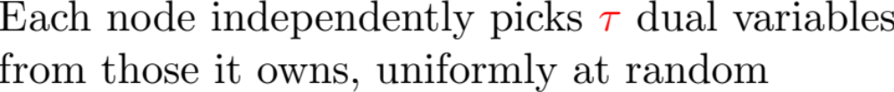

Distributed Sampling
Random set of
dual variables

Slide 26

Distributed Sampling & Distributed Coordinate Descent
Previously studied (not in the primal-dual setup):
Peter Richtárik and Martin Takáč
Distributed coordinate descent for learning with big data
arXiv:1310.2059, 2013
strongly convex & smooth
Olivier Fercoq, Z. Q., Peter Richtárik and Martin Takáč
Fast distributed coordinate descent for minimizing non strongly convex losses
2014 IEEE Int Workshop on Machine Learning for Signal Processing, 2014
2
convex & smooth
Jakub Marecek, Peter Richtárik and Martin Takáč
Fast distributed coordinate descent for minimizing partially separable functions
arXiv:1406.0238, 2014

Slide 27
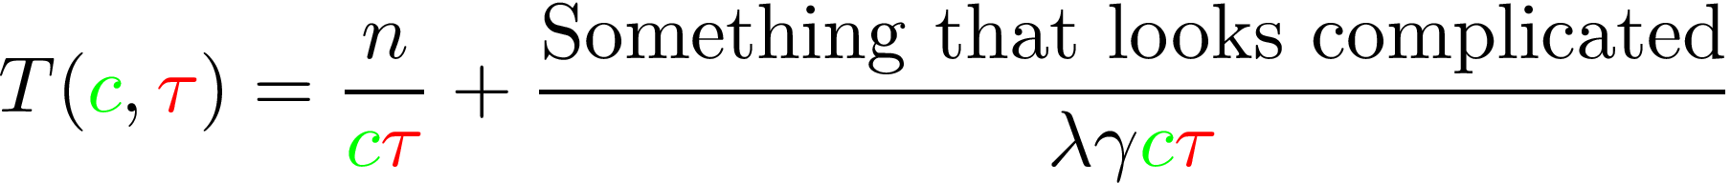
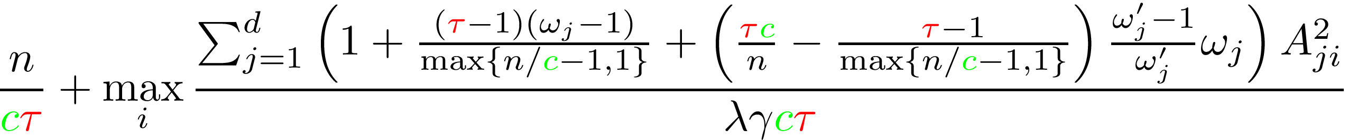
Complexity of Distributed QUARTZ
\[\frac{n}{c\tau} + \max_i\frac{\lambda_{\max}\left( \sum_{j=1}^d \left(1+\frac{(\tau-1)(\omega_j-1)}{\max\{n/c-1,1\}}+ \left(\frac{\tau c}{n} - \frac{\tau-1}{\max\{n/c-1,1\}}\right) \frac{\omega_j'-1}{\omega_j'}\omega_j\right) A_{ji}^\top A_{ji}\right)}{\lambda\gamma c\tau}
\]

Slide 28
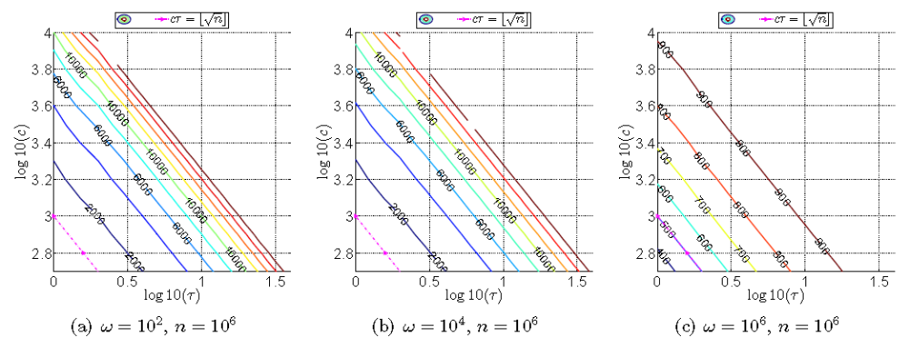
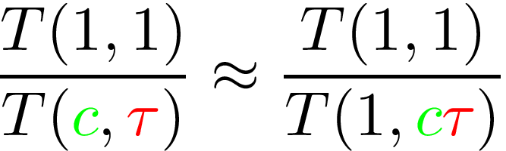
Reallocating Load: Theoretical Speedup

Slide 29
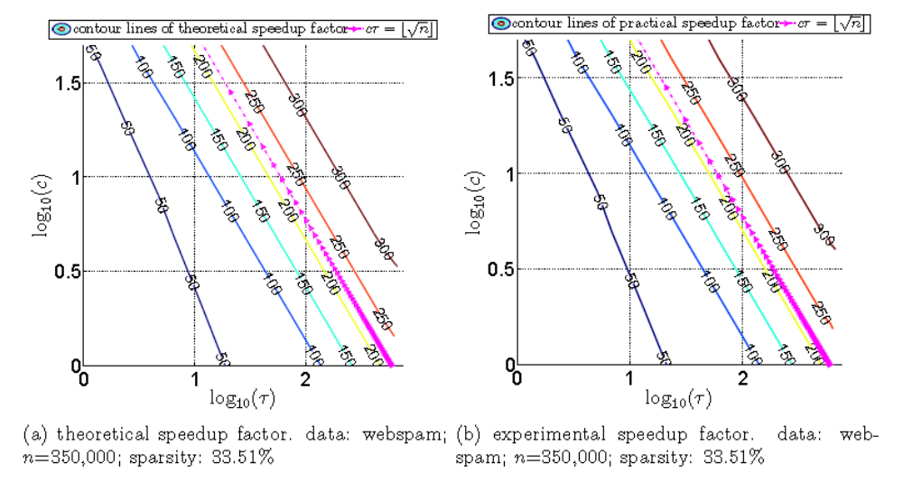
Theoretical vs Practical Speedup
Notes:
notes

Slide 30
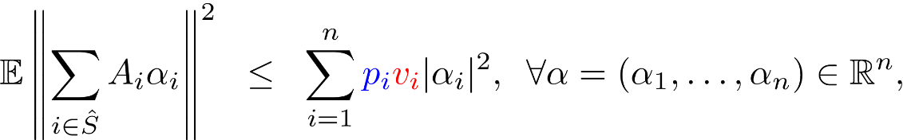







More on ESO
ESO:
get
lost
local second order /curvature information
second order /curvature information

Slide 31
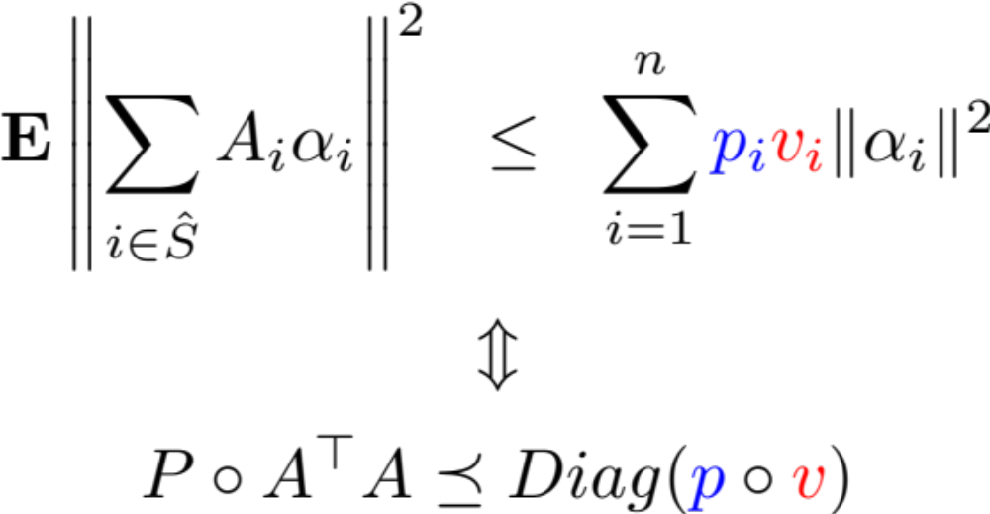
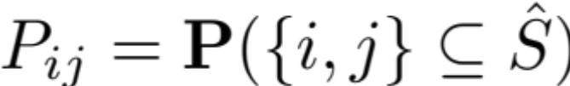

Computation of ESO Parameters
\[A = [A_1,A_2,\dots,A_n]\]
Lemma (QR’14b)
Sampling
Data
\[ \mathbf{E} \left\| \sum_{i\in \hat{S}} A_i \alpha_i\right\|^2 \;\;\leq \;\; \sum_{i=1}^n {\color{blue} p_i} {\color{red} v_i}\|\alpha_i\|^2 \]
\[\Updownarrow\]
\[ P \circ A^\top A \preceq Diag({\color{blue}p}\circ {\color{red}v})\]

Slide 32
Conclusion
QUARTZ (Randomized coordinate ascent method with arbitrary sampling )
  Direct primal-dual analysis (for arbitrary sampling)
    optimal serial sampling
    tau-nice sampling (mini-batch)
    distributed sampling
  Theoretical speedup factor which
    is a very good predictor of the practical speedup factor
    depends on both the sparsity and the condition number
    shows a weak dependence on how data is distributed
Accelerated QUARTZ?
Randomized fixed point algorithm with relaxation?
…?
Notes:
notes

